Slide 1


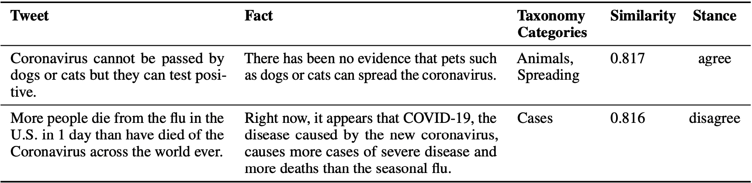
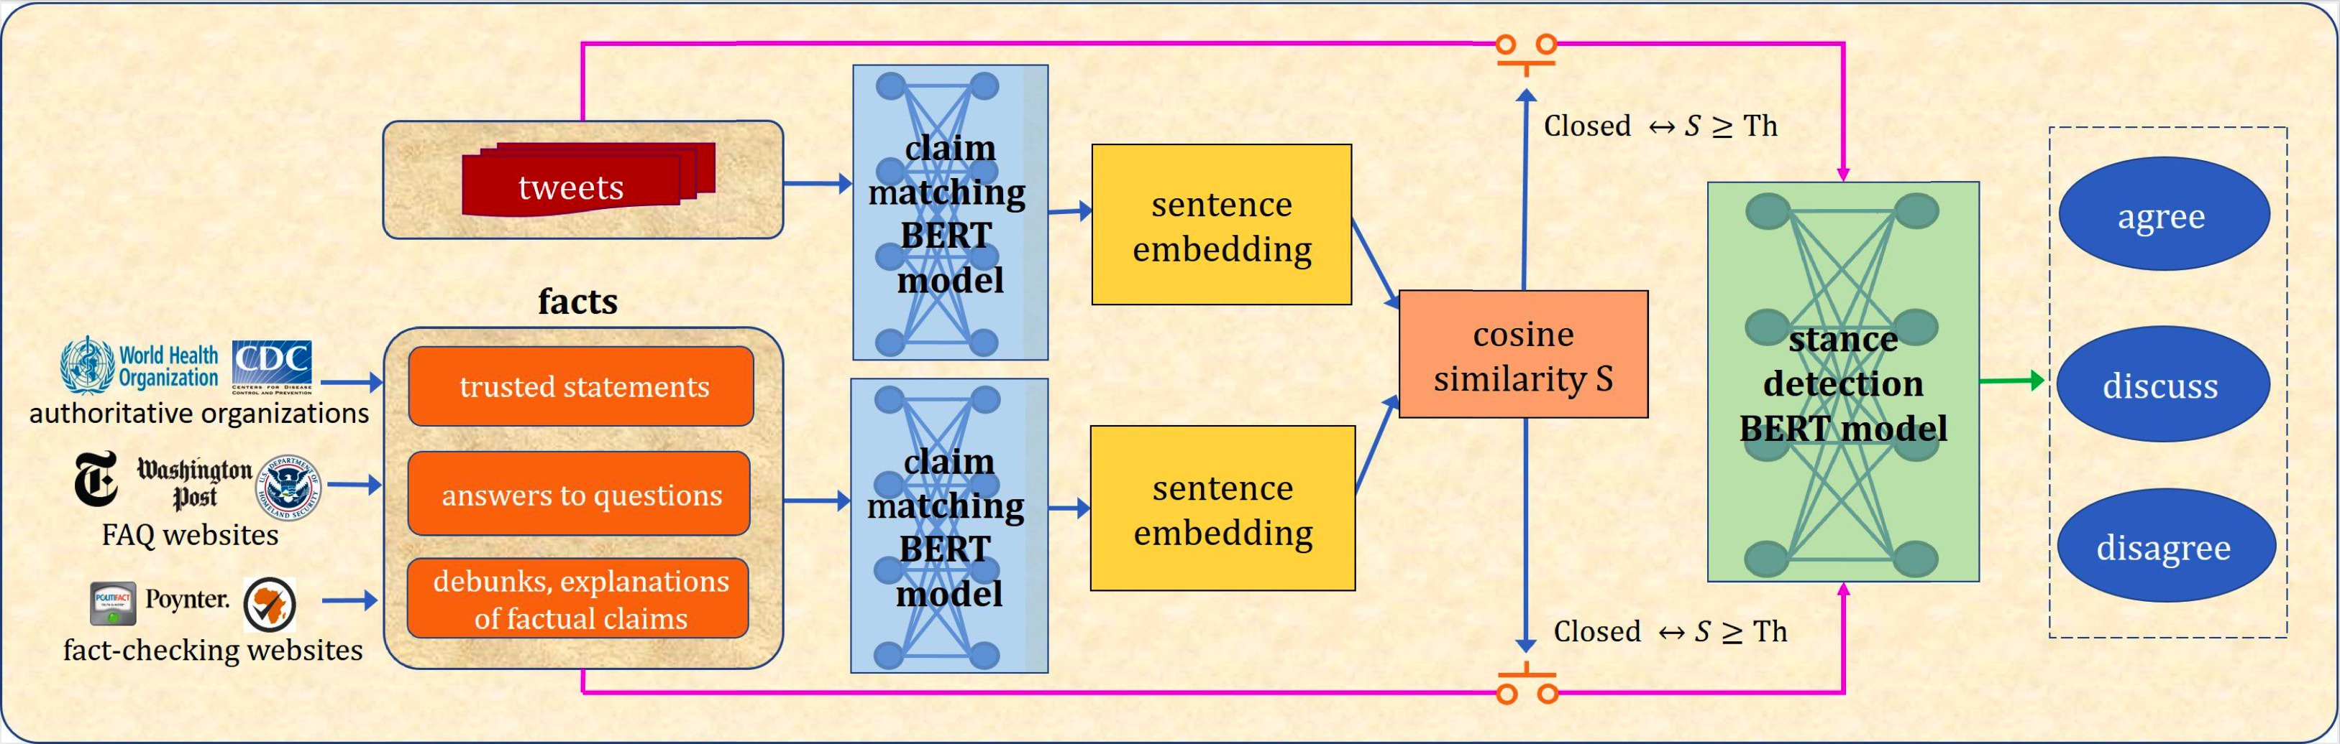
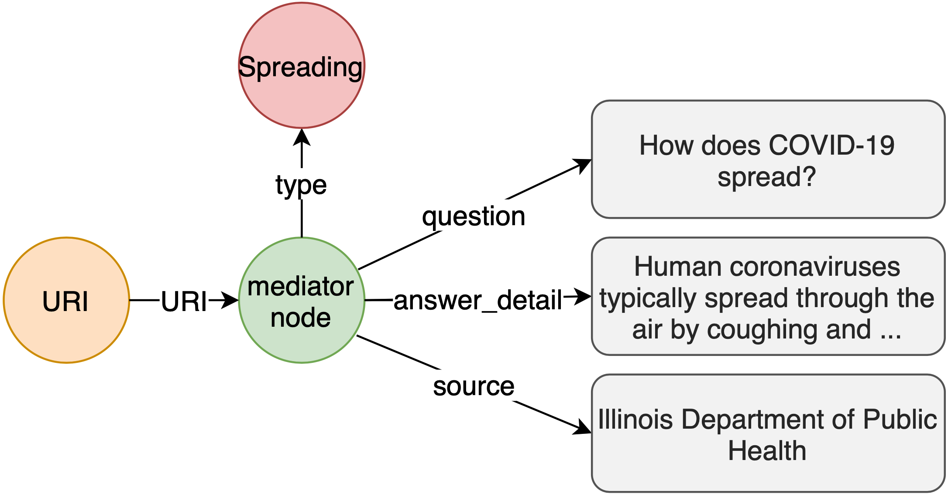
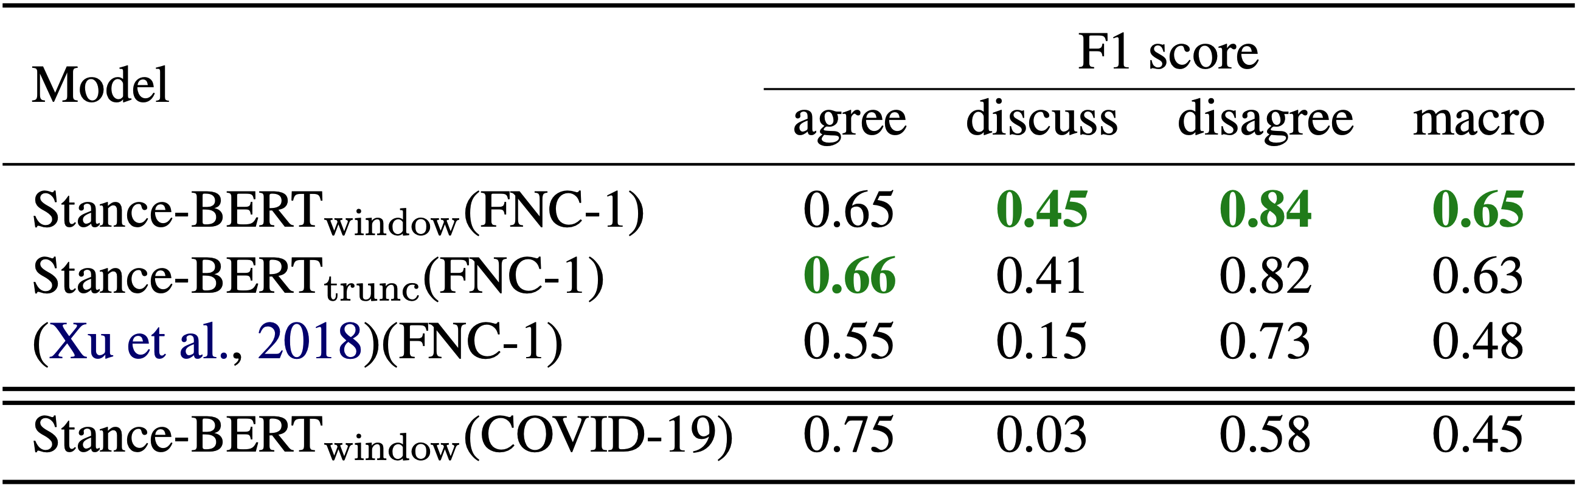
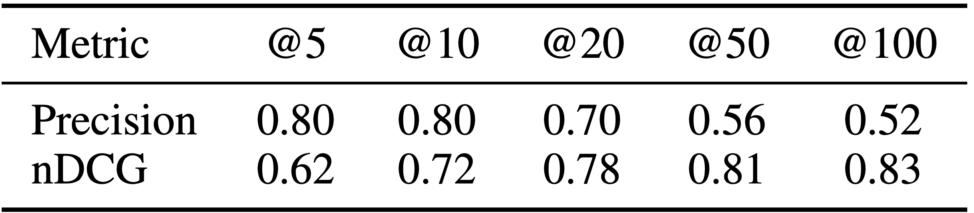
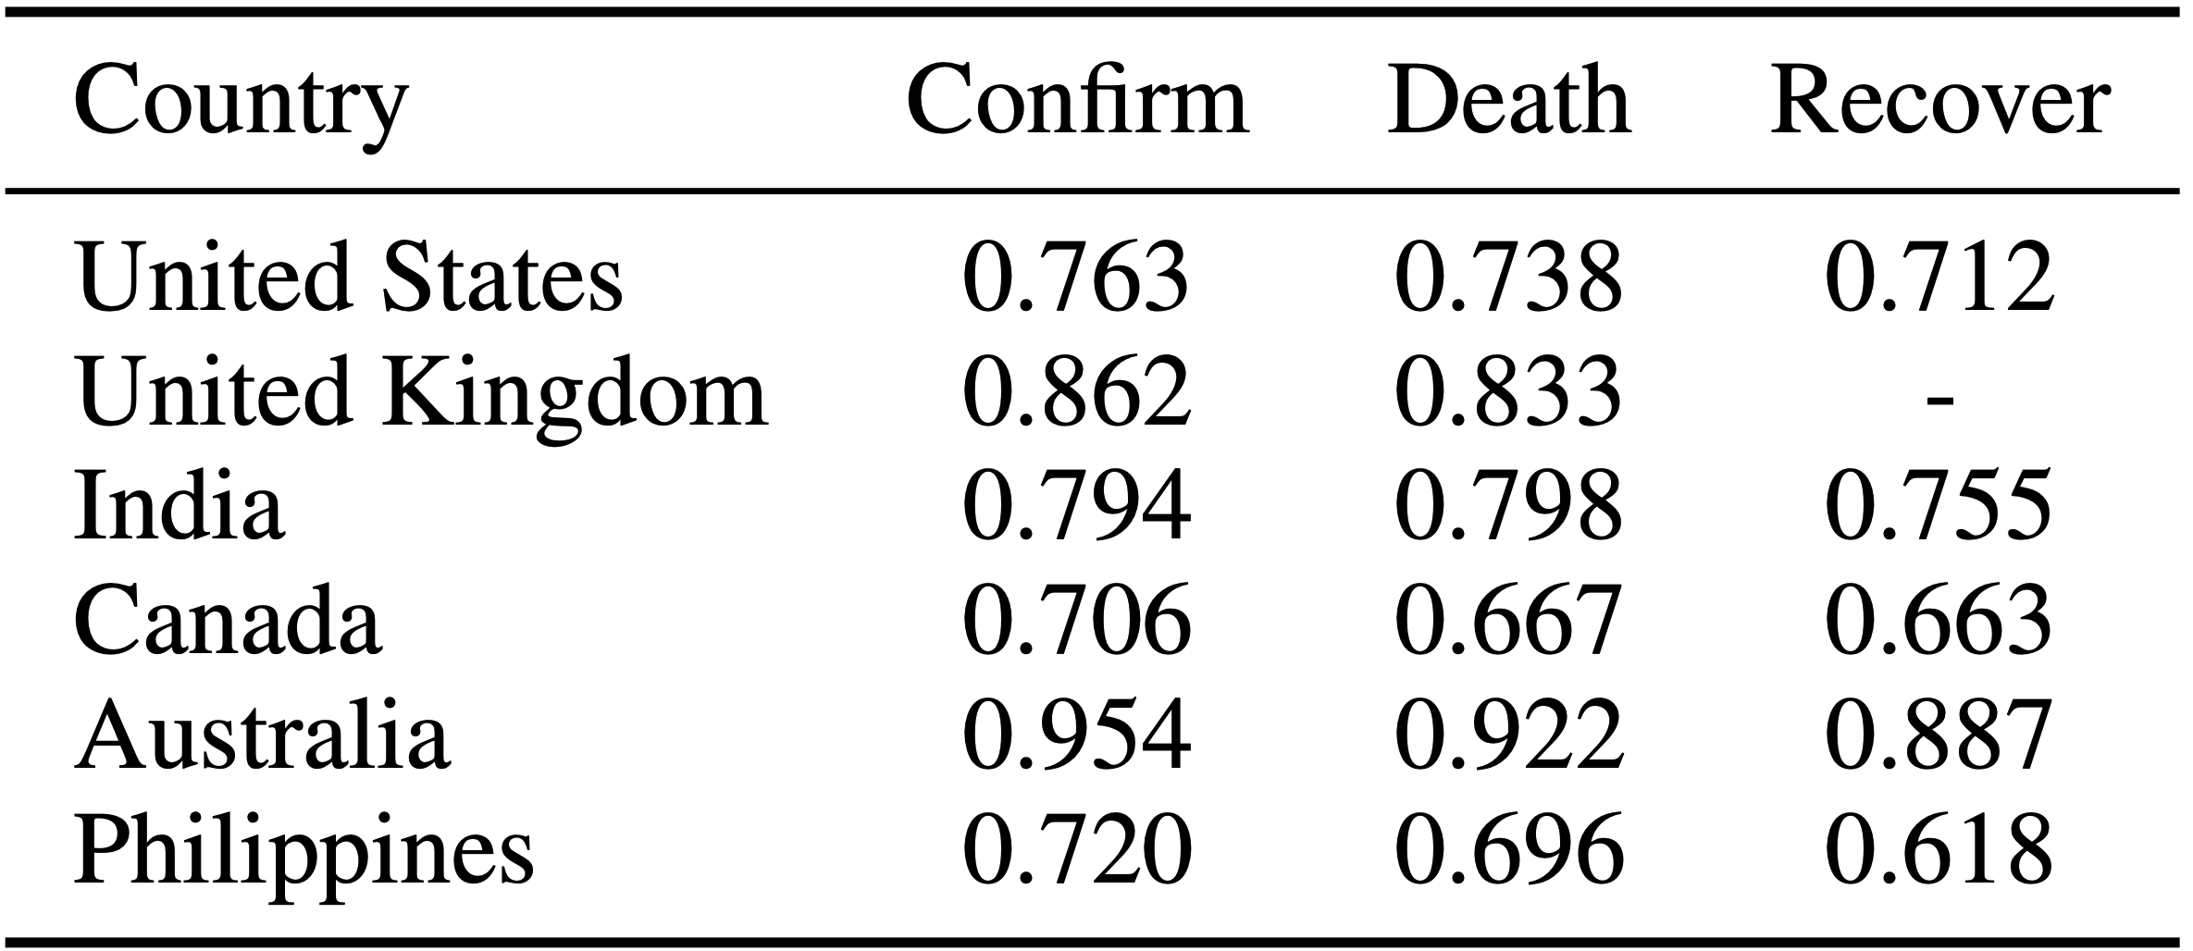
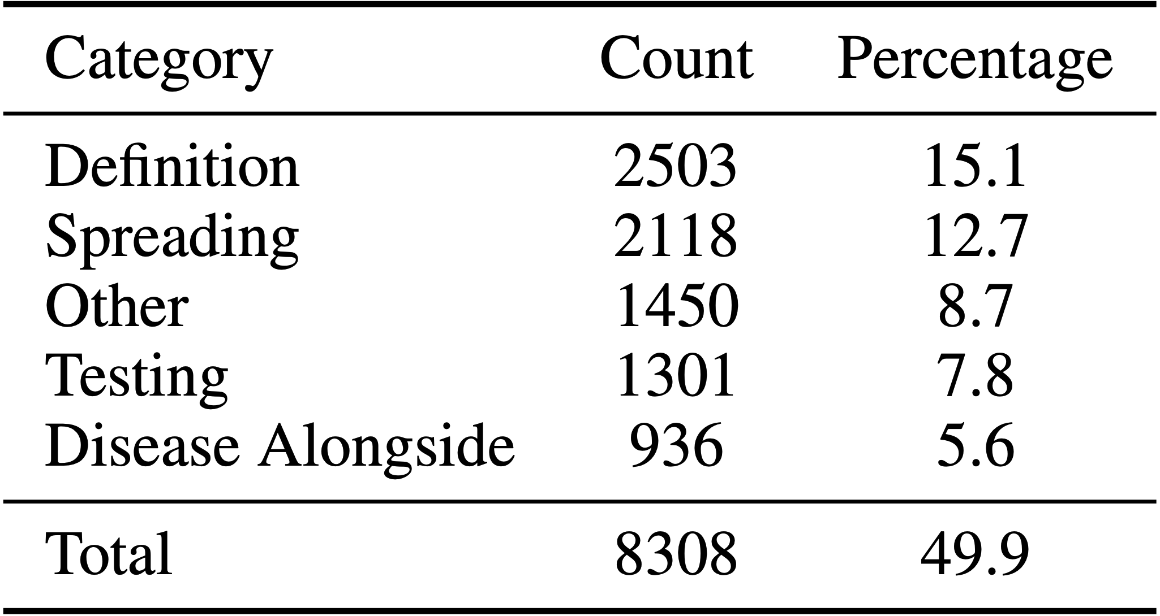
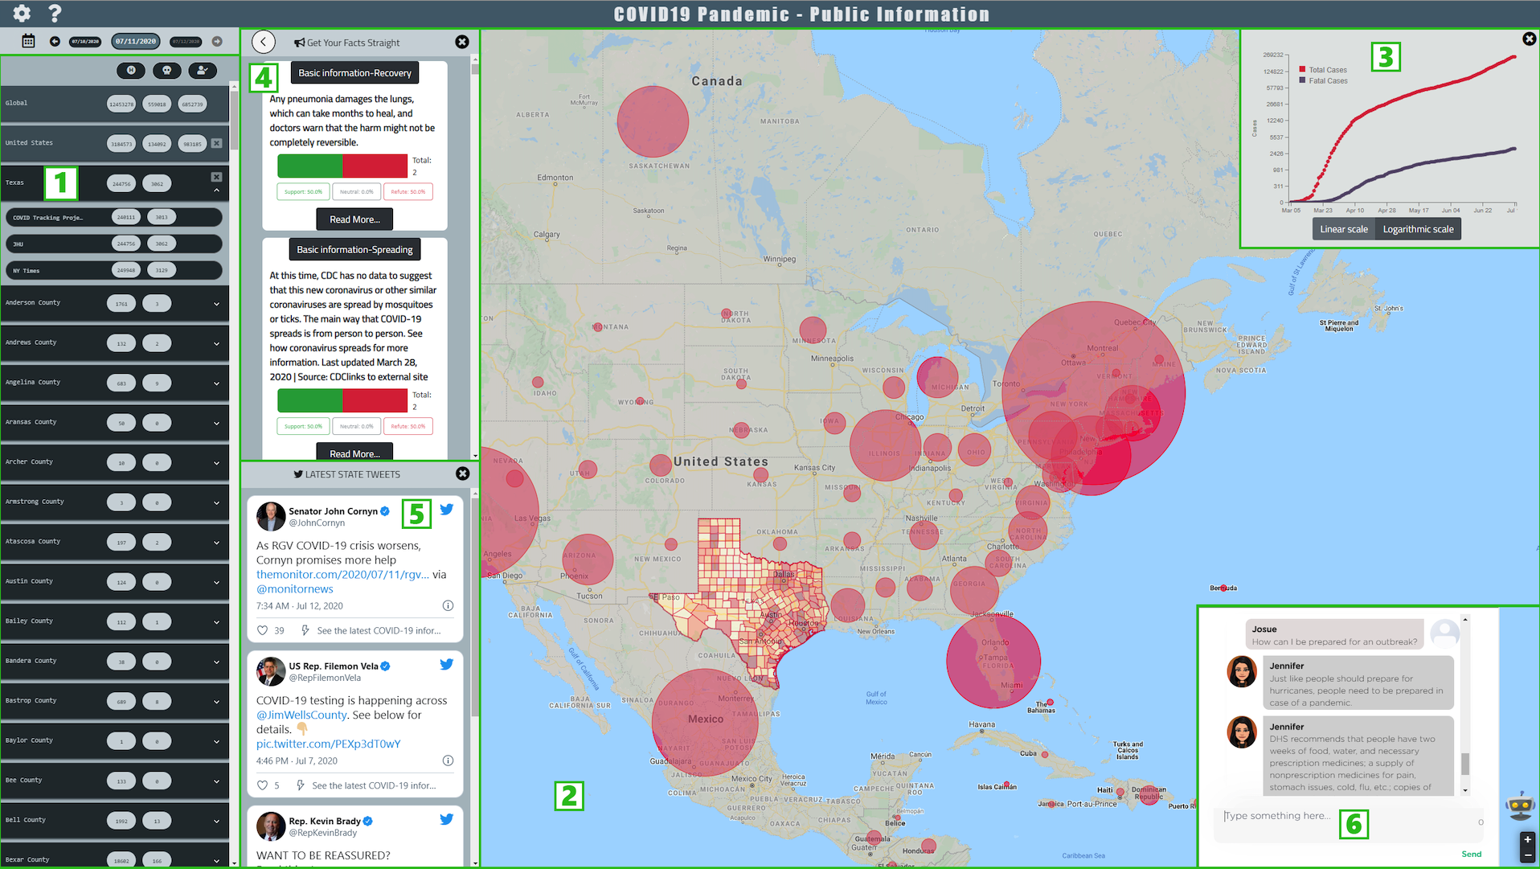
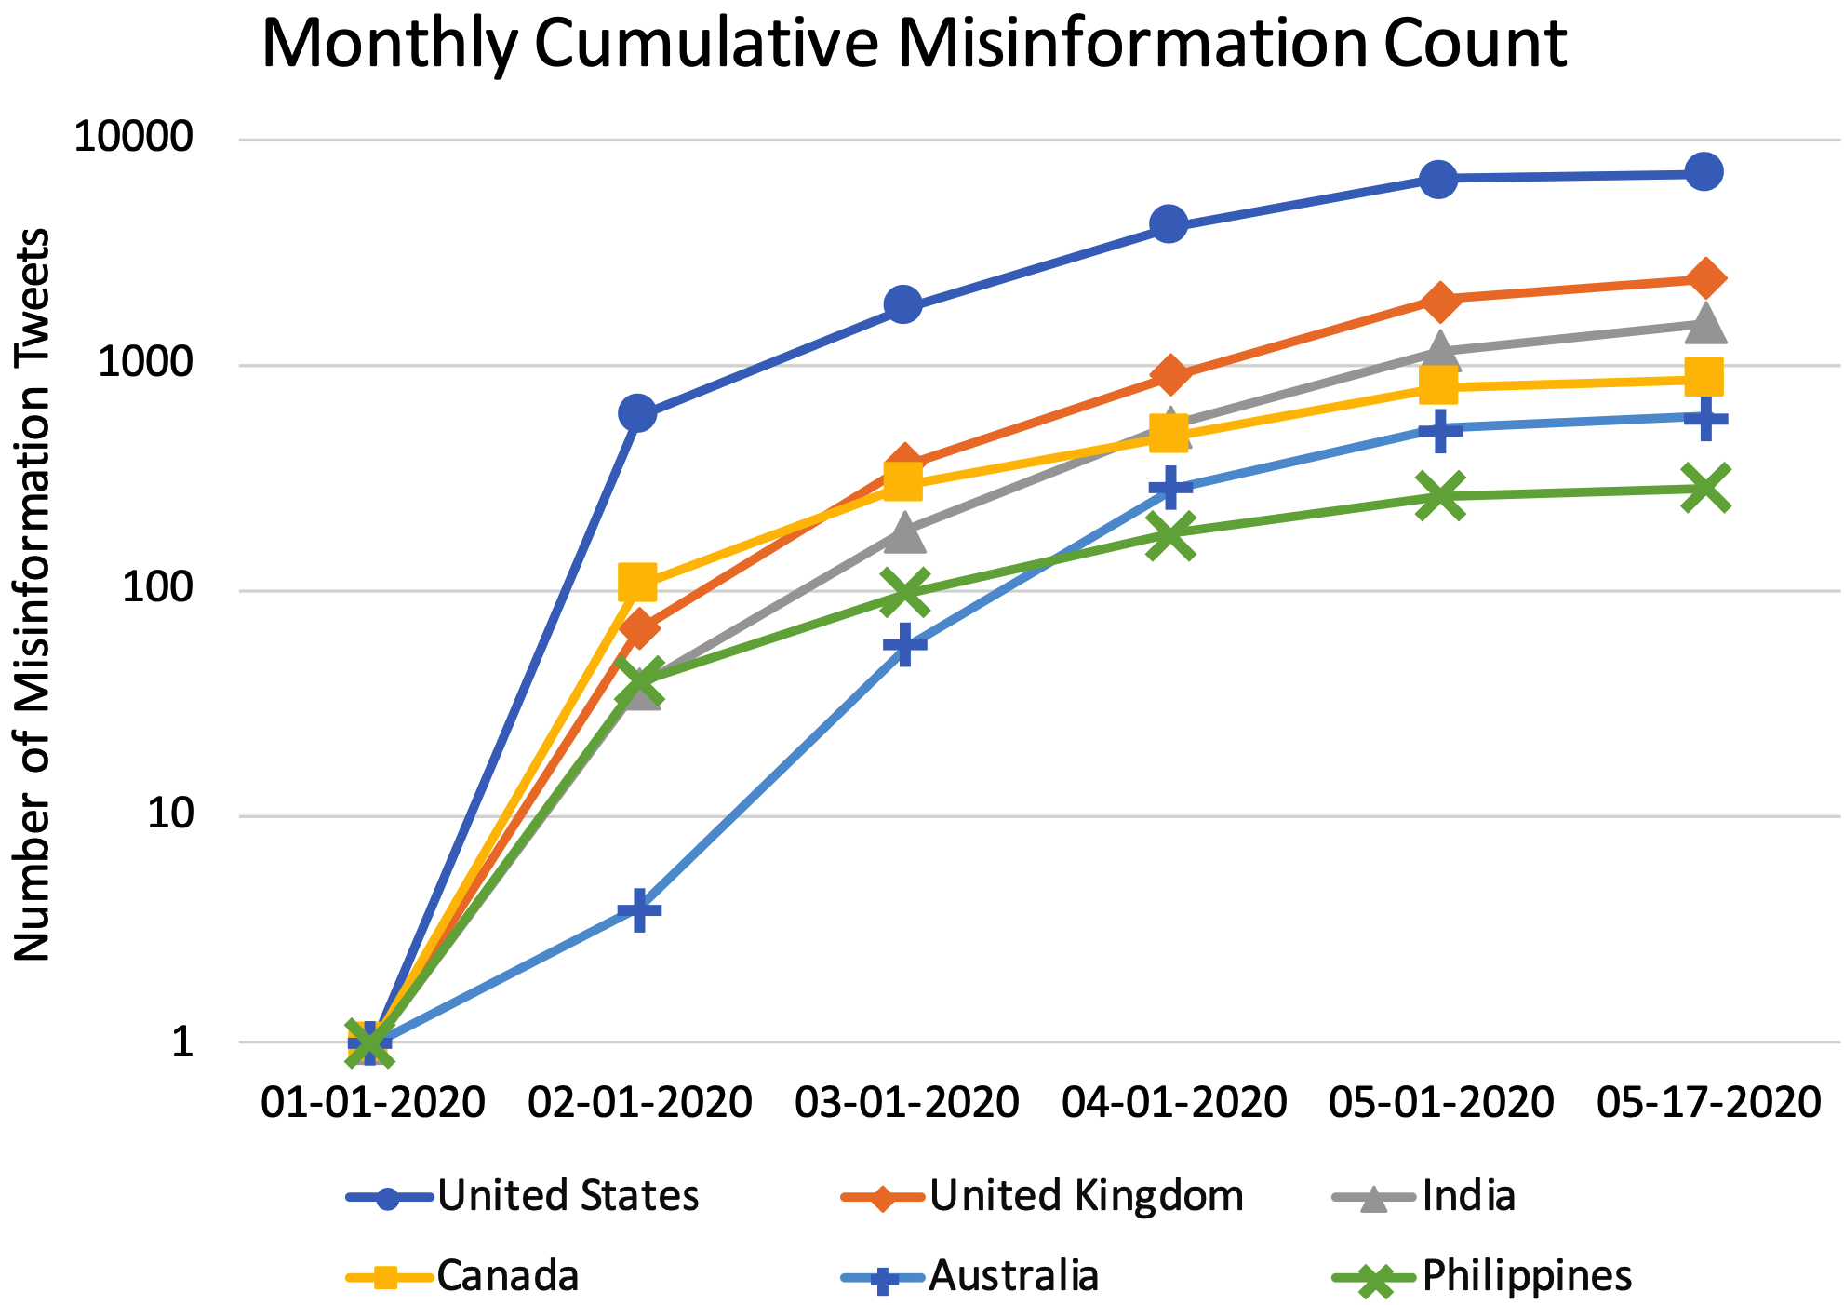
A Dashboard for Mitigating the COVID-19 Misinfodemic
Build and Broaden: Conference on Social Connections to Promote Individual and Community Resilience in Post-COVID-19 Society
Zhengyuan Zhu¹ Kevin Meng* Josue Caraballo¹ Israa Jaradat¹ Xiao Shi¹ Zeyu Zhang¹ Farahnaz Arkami¹ Haojin Liao¹ Fatma Arslan¹ Damian Jimenez¹ Mohammed Samiul Saeef¹ Paras Pathak¹ Chengkai Li¹
¹University of Texas at Arlington ²Massachusetts Institute of Technology
Innovative Data Intelligence Research Laboratory
System: idir.uta.edu/covid-19
The Quest to Mitigate the COVID-19 Misinfodemic
Social media posts make false and misleading claims
Misinformation exacerbates the vicious impact of the virus
Long-term goals: understand the surveillance of, impact of, and effective interventions against the COVID-19 misinfodemic
How the virus is transmitted
How authorities and people are responding to the pandemic
COVID-19 symptoms, treatments, and so on
Drown out credible information
Interfere with measures to contain the outbreak
Deplete resources and overloads the health care system
For surveillance, we seek to discover the patterns by which different types of COVID-19 misinformation spread
To understand the impact of misinformation, we aim to compare the spreading of the SARS-CoV-2 virus and misinformation and derive their correlations
Data Collection: Cases Counts, Tweets, COVID-19 Related Facts
Matching Tweets with Facts and Stance Detection
Counts of confirmed cases, deaths, and recoveries
Tweets from January 1st to May 16th, 2020
Johns Hopkins University
The New York Times (NYT)
The COVID Tracking Project
250 million COVID-19 related tweets
Remove tweets that do not have location information, and display the tweets based on locations on the dashboard
Resulting in 34.6 million remaining tweets
A catalog and a taxonomy of COVID-19 related facts.
9,512 entries from 21 credible website
Statements from authoritative organizations
Verdicts, debunks, and explanations of factual claims (of which the truthfulness varies) from fact checking websites
FAQs both from credible sources (e.g., FDA, NYT)
All collected data are available at: https://github.com/idirlab/covid19data
End-to-End Stance Detection System Architecture
Catalog entries in RDF
Dataset: https://cokn.org/deliverables/7-covid19-kg/
Performance of Claim Matching
Performance of Stance Detection
Given the catalog of COVID-19 related facts and the tweets, locate a set of tweets that discuss each fact
Detect tweets’ stance toward fact
COVID-19 Dashboard GUI
Case Study: COVID-19 Misinformation Analysis
Components: 1) Geographic region selection panel. 2) Interactive map. 3) Timeline chart. 4) Panel of facts. 5) Government tweets. 6) Chatbot.
Correlation between the percentage of cases and the percentage of misinformation tweets
Most frequent categories of misinformation tweets

